Slide 1
INT222
HTML (Hypertext markup language)
Please Note: The slides are not a substitute for the readings
https://zenit.senecac.on.ca/~emile.ohan/int222/weekly/week02/

Slide 2
What is HTML?
HTML (HyperText Markup Language) is the set of markup symbols or codes inserted in a file intended for display on a World Wide Web browser page. The markup tells the Web browser how to display a Web page's words and images for the user.
HTML tags are enclosed in angle brackets - e.g. <h1>. Most html tags come in pairs - e.g. <h1> and </h1>
<h1> being the opening of the tag and </h1> being the closing of the tag. In between these tags you can add text-based content.
There are a few tags such as the <img /> tag that are not paired - these tags are known as empty tags.

Slide 3
HTML – cont’d
HTML tags are classified in three different categories:
Block-level
A block-level tag is a tag that creates large blocks of content like tables (<table>…</table>) or page divisions (<div>…</div>). They start new lines of text when you use them, and can contain other block tags as well as inline tags and text.
Inline-level
An inline tag is a tag that defines the text or data in the document. Using <span class="....."> ... </span> inside a paragraph causes the enclosed text between the <span> and </span> to be emphasized. Inline tags don't start new lines when they are used, and they generally only contain other inline tags and text or data.
Empty
An empty tag does not contain any text. Empty tags are simply used as markers. In some cases empty tags are used for whatever is contained in their attributes. Empty tags do not have closing tags. The <br />, <img />, <input />, <meta /> tags are a few examples of empty tags.

Slide 4
Tags vs. elements vs. attributes
The terms tag, element & attribute are used throughout the web site. You should note the difference between these terms.
<p>Some text</p> - is referred to as an element - starting tag - content - ending tag
<p> and </p> - are referred to as tags.
<p class="....">Some text</p> - class is an attribute

Slide 5
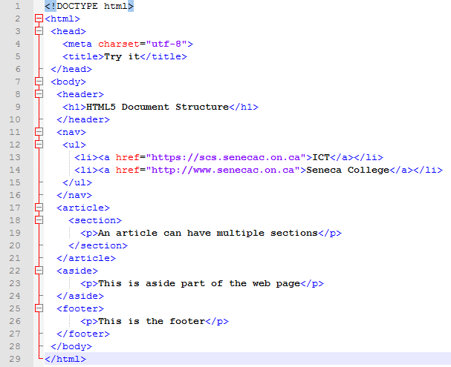
Basic HTML5 Document
Notice the first line: <!DOCTYPE html> :
The “DOCTYPE” is aninstruction to the web browser about what version of HTML the page is written in. “!DOCTYPE html” indicates an HTML5 document
Typically, an HTML5 document contains (at minimum) the following basic elements:
<html>…</html>
<head>…</head>
<body>…</body>
https://zenit.senecac.on.ca/~emile.ohan/int222/examples/week-02/html5Plus.html

Slide 6
Basic HTML Tags
html tag | Description | <!DOCTYPE html> <html lang="en"> <head> <title>Example</title> <meta charset="utf-8" /> <link href="...." /> <script src="......" ></script> </head> <body> html tags .... <!-- comment(s) --> html tags .... </body> </html>
<!DOCTYPE> | Specifies the document type
<html> | Specifies an html document
<head> | Specifies information about the document
<title> | Specifies the document title
<meta> | Specifies meta information
<link> | Specifies a resource reference
<script> | Specifies a script
<style> | Specifies a style definition
<body> | Specifies the body element
<!--...--> | Specifies a comment

Slide 7
HTML Heading Tags
Demo Links: Headings Headings with reset |  | <h1>.......</h1> <h2>.......</h2> <h3>.......</h3> <h4>.......</h4> <h5>.......</h5> <h6>.......</h6>
<h1> | Specifies a heading level 1
<h2> | Specifies a heading level 2
<h3> | Specifies a heading level 3
<h4> | Specifies a heading level 4
<h5> | Specifies a heading level 5
<h6> | Specifies a heading level 6

Slide 8
p, blockquote, pre, br, hr tags
Demo Links: Paragraphs & more |  | <p>.......</p> <blockquote>.......</blockquote> <pre>.......</pre> <br /> <hr />
<p> | Specifies a paragraph
<blockquote> | Specifies a long quotation
<pre> | Specifies preformatted text
<br /> | Inserts a single line break
<hr /> | Specifies a horizontal rule

Slide 9
Presentation tags
Demo Links: Presentation tags -1- Presentation tags -2- (use CSS instead) |  | <b>.......</b> <em>.......</em> <i>.......</i> <u>.......</u> <sub>.......</sub> <sup>.......</sup>
<b> | Specifies bold text
<em> | Specifies emphasized text
<i> | Specifies italic text
<u> | Specifies text to be underlined
<sub> | Specifies subscripted text
<sup> | Specifies superscripted text

Slide 10
HTML list tags – Unordered Lists
Demo Link: Unordered lists The <ul> tag displays an unordered bulleted list. You can use CSS to control the bullet style. The <li> tag is used to designate the individual list items in the list. Both the <ul> and the <li> require a closing tag (</ul> and </li>). |  | <ul> <li> ...... </li> <li> ...... </li> <li> ...... </li> </ul>
<ul> | Specifies an unordered list
<li> | Specifies a list item

Slide 11
HTML list tags – Ordered Lists
Demo Link: Ordered lists The <ol> tag displays an ordered list. You can use CSS to control the sequence style. The <li> tag is used to designate the individual list items in the list. Both the <ol> and the <li> require a closing tag (</ol> and </li>). |  | <ol> <li> ...... </li> <li> ...... </li> <li> ...... </li> </ol>
<ol> | Specifies an ordered list
<li> | Specifies a list item

Slide 12
HTML list tags – Definition Lists
Demo Link: Definition lists The <dl> encloses a definition list. A definition list contains terms, which are defined with the <dt> tag, and definitions, which are defined with the <dd> tag. The <dl>, <dt> and the <dd> require a closing tag (</dl>, <dt> and </dd>). By default, a browser will align terms on the left and indents each definition on a new line. The intent of a definition list is to display lists of terms and their corresponding definitions, such as in a glossary. |  | <dl> <dt> ...... </dt> <dd> ...... </dd> <dd> ...... </dd> <dt> ...... </dt> <dd> ...... </dd> </dl>
<dl> | Specifies a definition list
<dt> | Specifies a definition term
<dd> | Specifies a definition description

Slide 13
HTML list tags – Nested Lists
Demo Link: Nested Lists Ordered lists and Unordered lists can be nested - a combination of the two can also be nested. Each level will indented. Nested lists may look complicated however you just need remember the basic structure for ordered and unordered lists. | <ol> <li> ...... </li> <li> ...... </li> <li> ...... <ul> <li> ...... </li> </ul> </li> <li> ...... </li> <li> ...... </li> </ol>

Slide 14
Hyperlinks
Hyperlinks - source & destination
A hyperlink is a relationship between two locations: source and destination.
The link starts at the "source" anchor and points to the "destination" anchor, which may be any Web resource (ie: image, a video clip, a program, an HTML document, an element within an HTML document, etc.)
Basic HTML link (anchor) format
<a href="URL.................">text</a>
Absolute link
<a href="https://scs.senecac.on.ca/~facultyname">John Doe's Website</a>
Relative link
<a href="xxxxx.html">Text...text</a>
<a href="../xxxxx.html">Text...text</a>
<a href="info/xxxxx.html">Text...text</a>

Slide 15
Images
In order to include an image within the page, we use an empty tag: <img /> and specify it’s “src” attribute
For example:
<img src=“http://dummyimage.com/300x200/2a2a2a/eee” />
“src” can specify either an absolute or relative path to an image on your server

Slide 16
Hyperlinks – cont’d
Link to a particular section of an html page
<a href="xxxxx.html#int222">Text...text</a>
NOTE: To link to a specific section (int222) of a page named (xxxxx.html), it is assumed that somewhere in (xxxxx.html) the following attribute is defined: id="int222"
Link to a particular section in current page
To link to a specific section (top) in the current html, it is assumed that somewhere in current html document the following attribute is defined: id="top"
E-mail link
<a href="mailto:demo@myseneca.on.ca">Text...text</a>
Link with an Image
<a href="xxxxx.html"><img src="action.gif" alt="Text..." /></a>
Target link
Not recommended (with the exception of target=“_blank” – this forces the browser to open the link in a new window / tab)
So, try not to use: <a href="xxxxx.html" target="window_name">Text...text</a>
Instead use<a href="xxxxx.html" target=“_blank">Text...text</a>

Slide 17
Table Tags
Demo Link Basic table tags |  | <table> <caption>.......</caption> <tr> <th>.......</th> <th>.......</th> </tr> <tr> <td>.......</td> <td>.......</td> </tr> </table>
<table> | Specifies a table
<caption> | Specifies a table caption
<tr> | Specifies a table row
<th> | Specifies a table header
<td> | Specifies a table cell / detail
- Attributes | A lot of these attributes have been declared as being obsolete features in HTML5. We need to use CSS instead border - applies to the table tag width - applies to the table, td, th tags cellspacing - applies to the table tag cellpadding - applies to the table tag colspan - applies to the td, th tags rowspan - applies to the td, th tags align - applies to the table, caption, tr, td, th tags valign - applies to the tr, td, th tags Demo Link: Nested tables

Slide 18
Questions?
Any questions?
Would you like to see any more examples?

